Slide 1

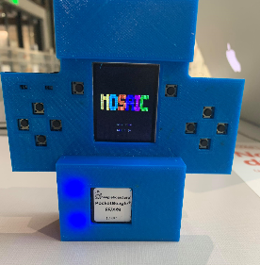
May 2021
TI PocketBeagle GamePup
Jaelyn Bethea, Andrew Brown, Joshua Iwe, Bibartan Jha, Eeshan Sarmah, Darius Zinolabedini
Team: I9
Industry Mentor: Martin Gao
Faculty Mentor: Dr. Brian Evans
The University of Texas at Austin
Notes:
Hello and Good afternoon my name is Jaelyn (everyone else fill in)
And together we make up Team 19:
Today we will be giving a presentation over our senior design project: Pocket beagle Gamepup

Slide 2
Agenda
Design Background
Design Solution
Design Evaluation
Future Steps
Questions
Notes:
Here is an overview of what our team will be covering today. We will discuss the purpose and design problem behind our project, the solution our team came up, as well an an evaluation of that solution, lastly we will discuss future steps that could enhance the final design as well as leave time for questions

Slide 3
Design Background
Notes:
We will begin the presentation by giving some background information.

Slide 4
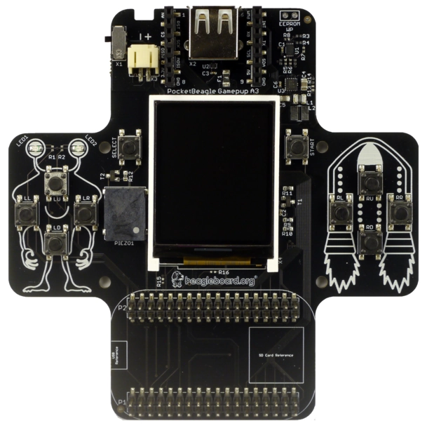
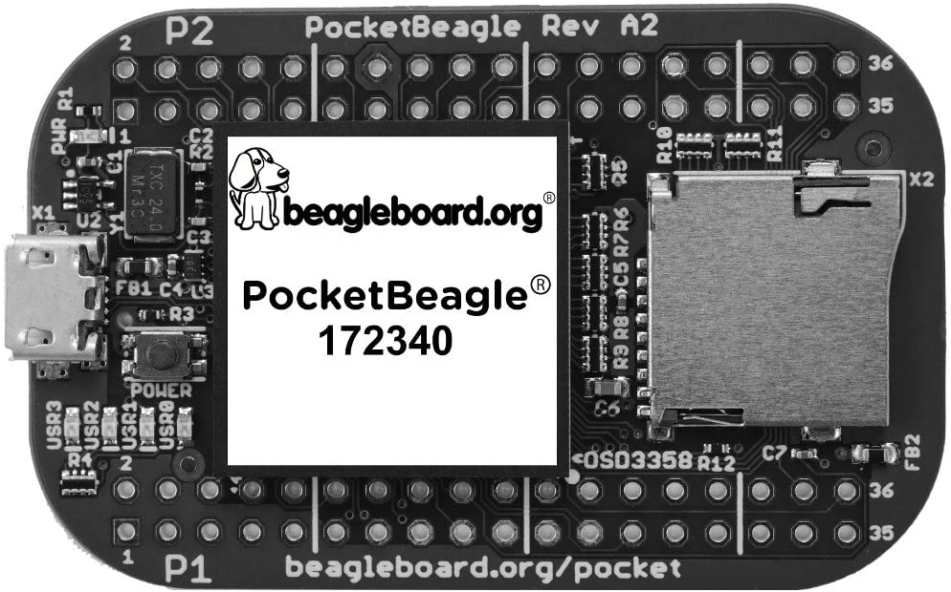
Design Problem
Design handheld portable gaming device using PocketBeagle and GamePup Cape
Notes:
This project is sponsored by Texas Instruments, a company that specializes in semiconductors and integrated circuits. For this project, Texas Instruments provided us two pieces of technology: the Pocket beagle, and GamePup Cape. Our team was asked to design an emulator that can support the playing of multiple games using the Pocket beagle and GamePup Cape. An emulator is typically a software that imitates a physical gaming system allowing the user to play any games that they have a software copy of. However, the PocketBeagle GamePup project differs from the traditional emulator in that it will integrate hardware aspects such as an external power source (battery), buttons, and a physical screen.

Slide 5
Design Requirements
Enclosure
Battery system
Software user interface
Host multiple games
Demonstrate capabilities of the PocketBeagle and GamePup
Notes:
(Jaelyn)
Our team was given a few design requirements. The final system must be complete with an enclosure, a battery system and a Software User Interface. Not only must the system be portable, but it should also contain sensor input capabilities (such as buttons) as well as output capabilities (a graphical display and sound) that allow users to interact with the game being played on the system. Also, the completed project should consist of an emulator device that supports multiple games and demonstrate the capabilities of both the PocketBeagle and the GamePup Cape boards.

Slide 6
Purpose
Make sample product for game enthusiasts
Demonstrate a cost efficient method
Explore possible capabilities
Notes:
Through sponsoring this project, Texas Instruments aims to create a sample product for interested consumers and demonstrate a cost efficient method of small-scale game design. Another one of Texas Instruments’s objectives for this project is to expand upon the available documentation for the PocketBeagle and GamePup Cape. As of now, the PocketBeagle and GamePup Cape are not widely used boards and there is very little documentation online. As a result, Texas Instruments hopes that this project can serve as a reference for future groups to follow when working with these boards.

Slide 7
Design Solution
Notes:
I will now pass it off to Andrew to talk about our design solution

Slide 8
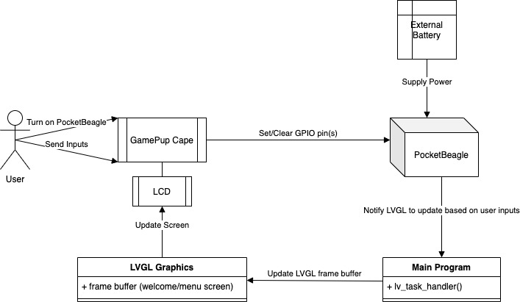
System Overview
Notes:
(AJ)
The two major subsystems for the project were hardware and software. Because these subsystems were large and quite broad, each subsystem is broken down into smaller modules. Each module had its own specific purpose or job within that subsystem. First, the user sends inputs by pressing buttons on the GamePup Cape. The GPIO pins on the PocketBeagle are then set or cleared depending on the user inputs. The main program on the PocketBeagle then updates the LVGL frame buffer to modify the display on the LCD screen. The frame buffer is then sent to the LCD screen on the GamePup Cape to update what the user sees on the LCD screen. The external battery provides power and portability to our game emulator.
All subsystems and their respective modules work together in order for the game emulator to function properly. Figure 2 gives a thorough system overview on how each subsystem of the project is dependent on each other. First, the user powers on the PocketBeagle and sends inputs by pressing different buttons on the GamePup Cape to select a game to play or to interact with the game currently in progress. Each input on the GamePup Cape is routed to a specific GPIO pin on the PocketBeagle. When the user sends an input, the value of the associated GPIO pin changes. Next, the main program continuously checks for a change from the PocketBeagle by calling lv_task_handler(). Once a change has been detected, the main program will update the LGVL frame buffer to show the new and appropriate display for the LCD screen on the GamePup Cape. While the external battery might appear independent from the other hardware and software components, the battery makes the project portable and provides a power source for the PocketBeagle. The following sections will provide a more detailed discussion of the modules within each subsystem and how those modules work together to create a portable game emulator

Slide 9
Parts: PocketBeagle
Microcontroller with a 1GHz processor
Notes:
(Eeshan)
Now we will discuss the different parts we used in the construction of our retro game emulator. First, we have the PocketBeagle which is an open source USB microcontroller made by BeagleBoard. It has a 1 GHz processor with ARM architecture and 512 MB DDR3 RAM integrated. There is micro SD card slot on which we installed an image of Debian Linux. In addition, there are 4 user LEDs that display information such as the Linux heartbeat and other troubleshooting messages. The PocketBeagle consists of 72 pin headers to allow accessories to connect, a microUSB port to allow for connection to a computer, and a microSD connector.

Slide 10
Parts: GamePup Cape
Hardware add-on to the PocketBeagle
Connects through GPIO headers
Notes:
Eeshan
The PocketBeagle is then connected through GPIO headers at the bottom of this daughterboard called the GamePup Cape. This cape serves as the function gaming platform to control the retro game ROMs loaded onto the PocketBeagle. This cape has 10 buttons, 2 LEDs, and a 160x128 LCD display in the middle. It also has a buzzer for any sound output as well as a Lithium Ion Polymer Battery Port for external battery support.

Slide 11
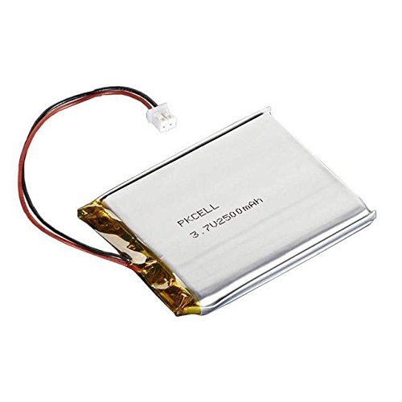
Parts: Battery
Lithium Ion Polymer Battery
3.7V, 2500mAh
Correct Polarity
Notes:
Eeshan
A battery was integrated into the game emulator in order to provide the portability like many other handheld systems. The team chose the EEMB 3.7V, 2500mAh Lithium ion Polymer Battery to power the PocketBeagle, as it has the correct polarity. This battery connects to the system through a JST port on the GamePup Cape which can only be connected in one orientation. The PCB traces on the cape for the positive and negative terminals in the battery are the opposite of most batteries the team initially considered, so choosing a battery with the correct polarity was important. The battery has a one hour battery life and is charged via the micro-usb port located on the PocketBeagle.

Slide 12
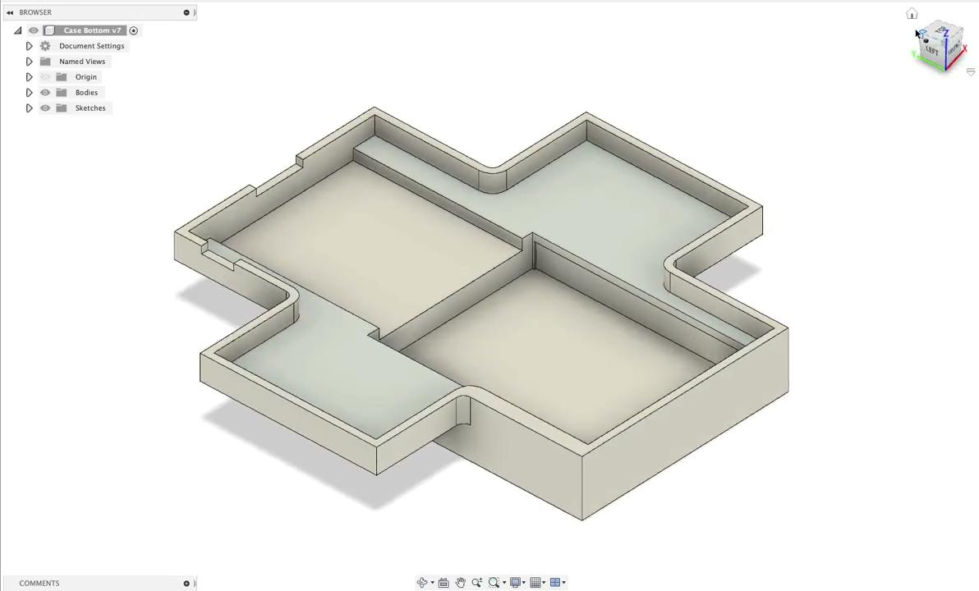
Parts: Case
Notes:
Eeshan
The last hardware component is the case enclosure. The case was designed through the cloud-based 3D modeling software Fusion 360 and using 3D printing facilities provided by the Texas Inventionworks at UT Austin. The actual case is divided into two major components: the base and the top. The base is a solid piece of ABS plastic in which the GamePup is first placed. This also has a cutout for the battery placement and subsequent wires. The top has cutouts for all the buttons, LEDs, the LCD screen, as well as any ports available.

Slide 13
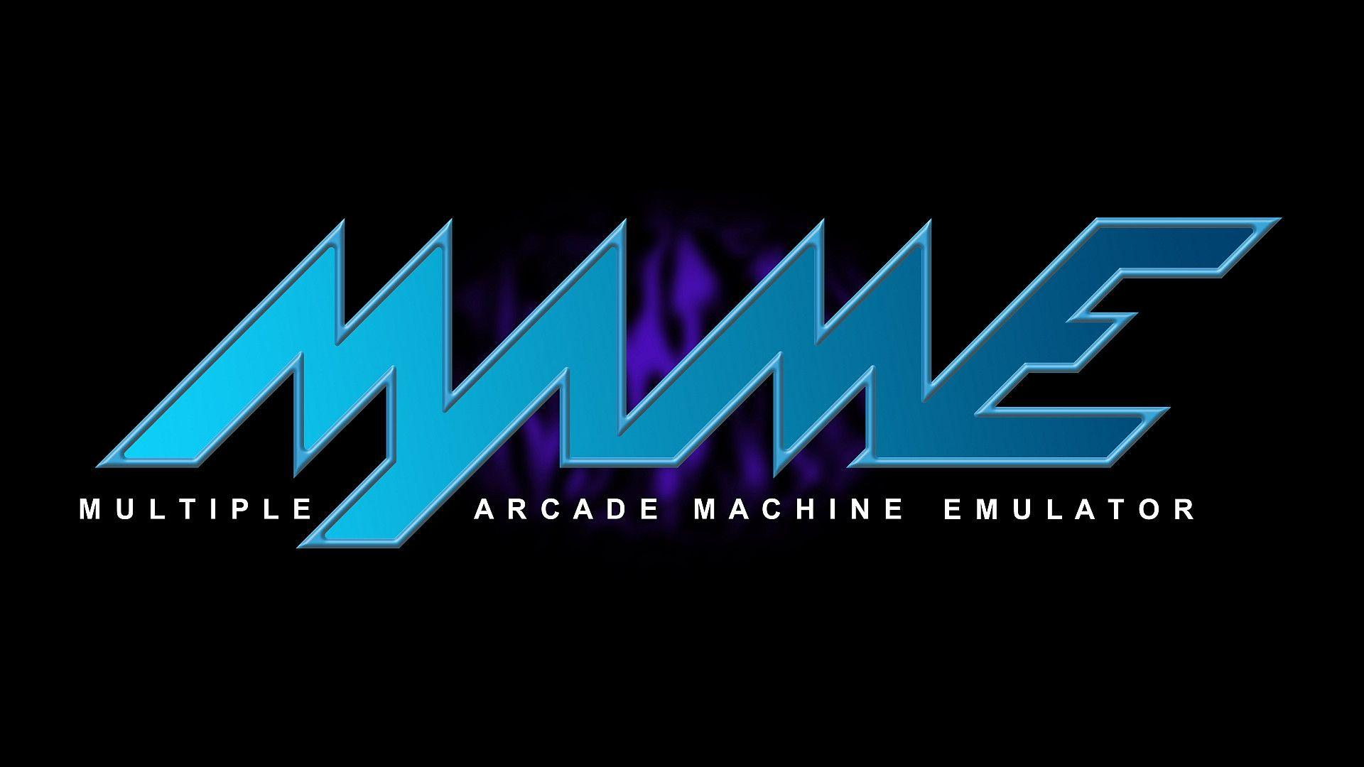

Software - Tools
Light and Versatile Graphics Library(LVGL)
AdvanceMAME
Notes:
Bib
Apart from the hardware, we used 2 main software tools as well. The first is LVGL, which is a high quality graphics library. We used LVGL in order to create the graphics and UI in the menu screen and welcome screen. There are many graphics libraries available, but we chose LVGL because it has a small memory footprint suitable for an embedded system like the PocketBeagle. We also chose it because it had extensive documentation online, which helped speed up development as we were able to find many examples online on how to use the library’s components.
The second software tools that we used is AdvanceMAME, which is an open-source game emulator. This served as the engine through which we can host various retro-style games on the PocketBeagle such as Pacman and Tetris. AdvanceMame was chosen because it could run on the limited constraints of the PocketBeagle. In addition , it is portable on Linux and has a wide range of pre-built and playable games.

Slide 14
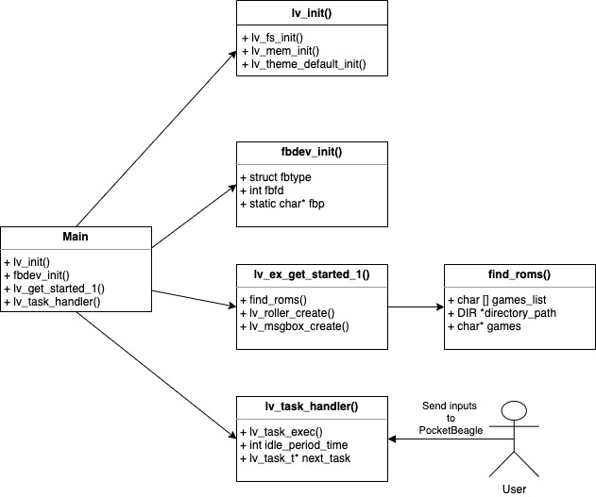
Software - Code
Display
Main program
Notes:
(AJ)Our software code is divided between the display and the main program. The display uses LVGL to hold the data that will be shown on the LCD. The main program first calls the initial display functions to show the welcome screen by calling lv_init() and fbdev_init(). The main program then collects all of the roms by searching through the contents of a specific directory in the file system. Once all of the roms have been collected, the menu screen is shown and the main program continuously waits for user inputs and then uses MAME to run the user-selected game.

Slide 15
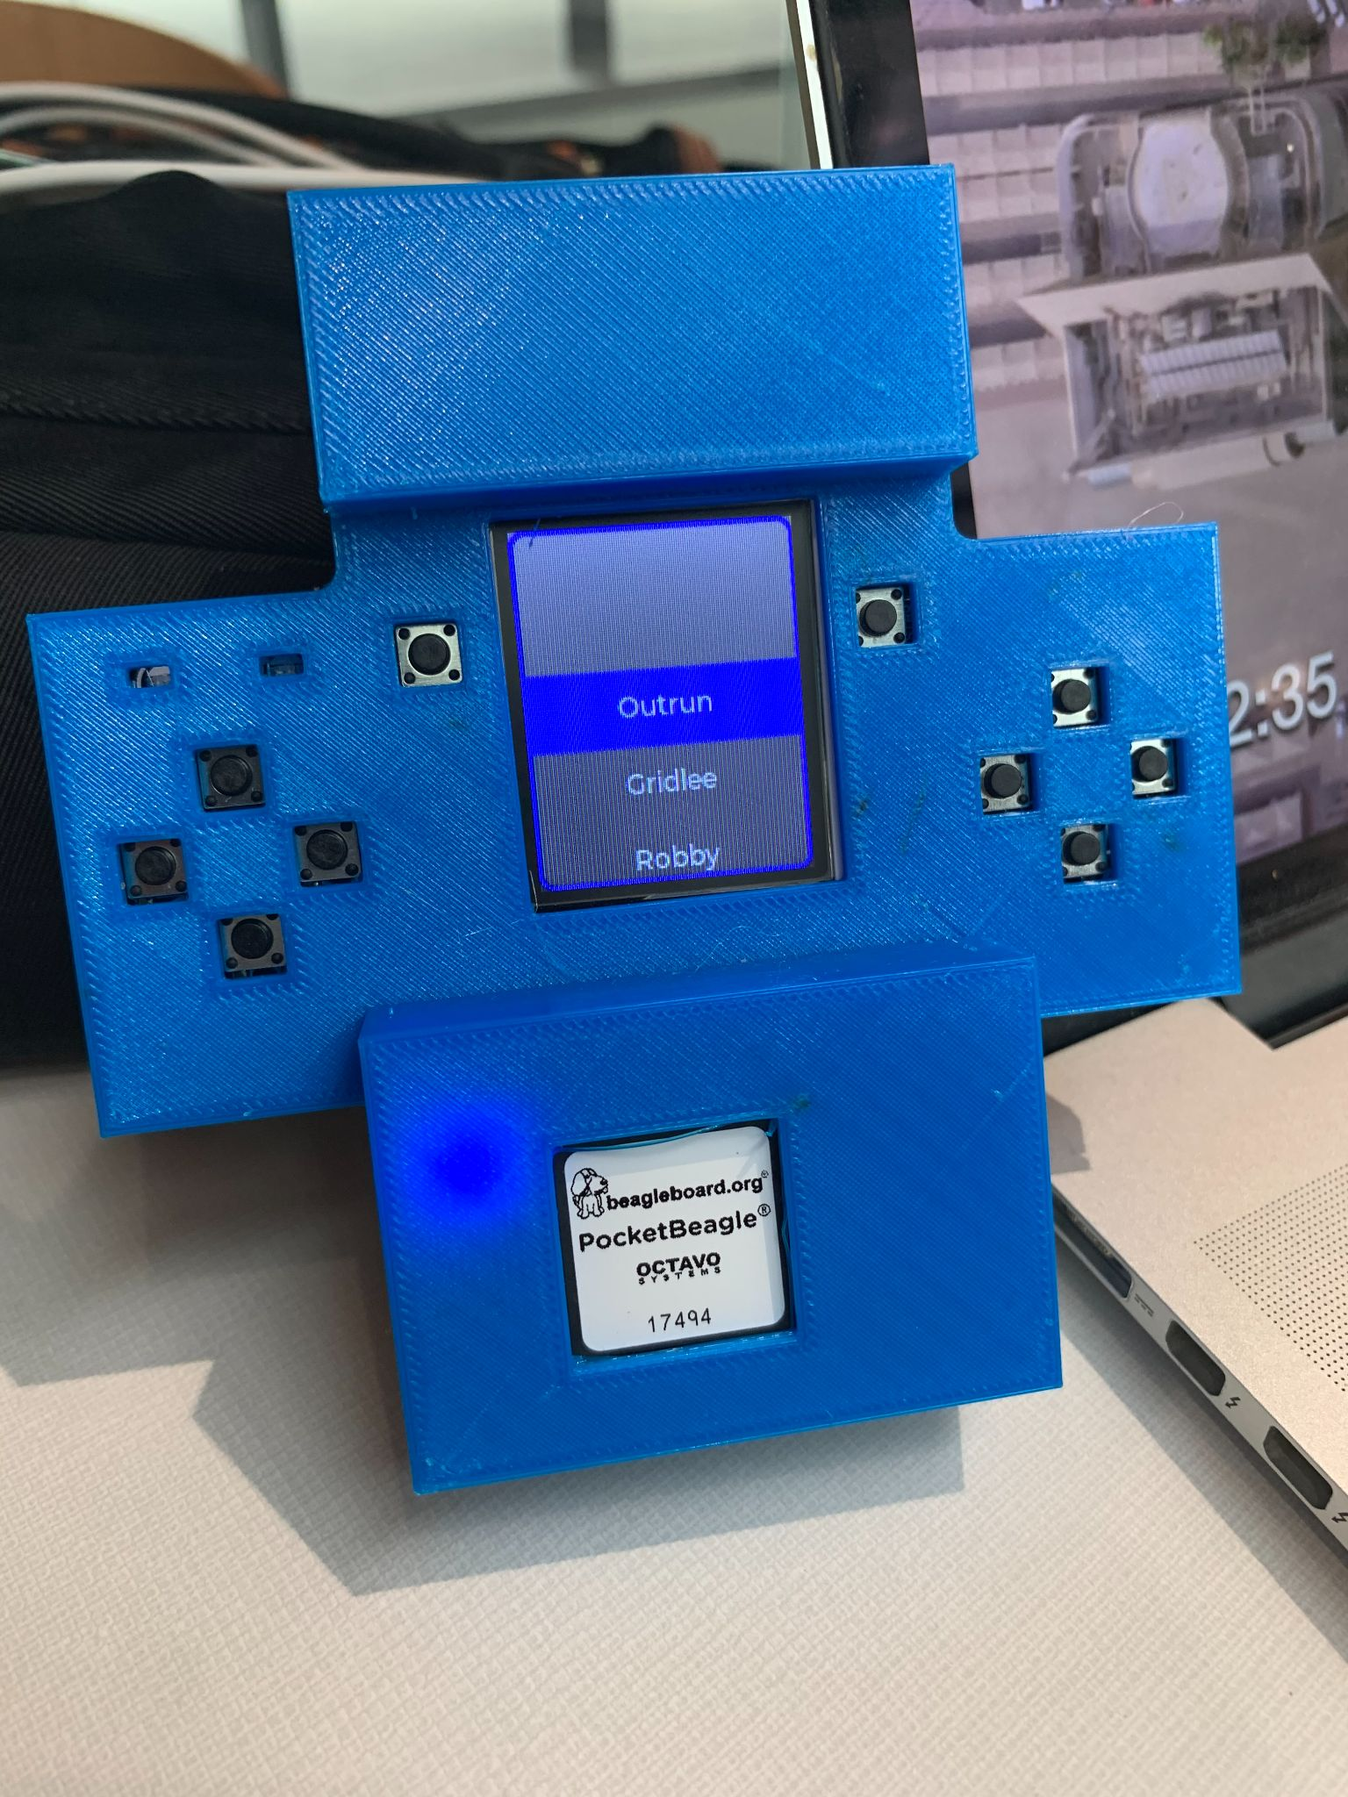
Final Product
Full system with case
Emulator with multiple roms
Notes:
Bib
We were successful in meeting our design requirements in creating a portable final game enclosure with an enclosure and battery. The main components accessible by the user are the LCD and buttons on the GamePup. Furthermore, we placed the battery within the case behind the GamePup. Furthermore, this emulator has 17 pre-loaded ROMS for the games, and the user can scroll through the menu screen to select one of these 17 games.

Slide 16

Demo
Notes:
Bib
Here, we are going to show a demo for our PocketBeagle. In this demo, we have already turned on the PocketBeagle, and we will show how to navigate through the menu screen, play a game, and return to the menu screen.

Slide 17
Design Evaluation
Notes:
now that background shit is out the way…. here was the solution our team game up with

Slide 18
Obstacles Faced
Obstacle | Resolution
COVID | Bi-weekly meetings
Lack of official documentation | Reached out to Jason Kridner (PocketBeagle CEO)
Software MAME Device Tree errors Sound driver ALSA error | Created custom device tree overlay Reverted Linux Kernel for compatibility
Notes:
(Darius)
“One of the big obstacles that we all faced during the last year was COVID. Being unable to meet up in person, debugging and making sure everyone was up to date a challenge. We resolved this, to the best of our abilities, during winter break by setting up two meeting times a week that everyone was able to attend. Since the PocketBeagle is relatively new and not widely utilized, there was little official documentation available explaining how to interface with the GamePup Cape. Prior to winter break, we reached out the CEO of BeagleBone, Jason Kridner, who pointed us in the direction of MAME which we used for the software. Lastly, the software errors. THe bigesst error we faced was with MAME and the Device tree. The device tree is file that assigns the gpio pins for hardware interfacing. The pre-existing device tree file locked out control of certain hardware that MAME required. Thus, we made a custom device tree file to allow MAME to operate without interference. The other software error we faced was an ALSA error we received when starting MAME. We fixed by switching to an older edition of the Kernel that was compatible.”

Slide 19
Innovations During Prototype Construction Phase
Service routine for MAME
Custom Device Tree
Removal of the battery enclosure
Notes:
(Josh)
During our construction phase we sought out a way to make the system to boot to our menu screen.
This lead to us creating a linux Service routine. Initially it started off as boot to mame but eventually we were able to direct it to menu then to game
Another big step we made during our prototyping phase was programming the Linux device tree to ensure our emulator and menu screen program both have access to the peripherals on the GamePup cape.
Lastly we were able to transition from a standalone battery enclosure to a full blown case for the entire system

Slide 20
Testing
Hardware
SD Cards
LEDs
Software
Service file tests
Functionality
Notes:
(Josh)
Hardware
-Initially sd cards were malfunctioning - safe power down
-LEDs interfaced with adafruit blinka - interfaced with scripts
Software - Service file tested with various sleep() times to prevent framebuffer conflicts
Functionality - integrating hw and sw - making sure buttons worked

Slide 21
Economic Aspects
Raw Material | Quantity | Per Unit Cost | Total Cost
PocketBeagle | 6 | $27.36 | $164.16
GamePup Cape | 6 | $48.00 | $288.00
Micro SD Card | 6 | $5.00 | $120.00
3.7V Lithium Ion Polymer Battery | 6 | $17.18 | $103.08
Case | 6 | $0.00 | $0.00
Total | 6 | $97.54 | $675.16
Notes:
(Darius)
“The cost considerations were far less pressing as the project fell below the budget constraints. Initially, the team's budget was only utilized by the hardware required for the design solution, the PocketBeagle and the GamePup Cape. However, during the fall semester, we ran into issues with the microSD cards malfunctioning, and each member purchased four additional cards in case of further errors. The last purchase required for the design solution were the 3.7V Lithium Ion Polymer Battery, as they were required to provide portability to the system. Our project was cost efficient as we were able to remain under the $1000 budget. One aspect that aided this that other groups may have to take into account was the ability to use the free 3D printing facilities provided by Texas Inventionworks to print the case.”

Slide 22
Ethical Aspects
User privacy
Intellectual property
Notes:
(Darius)
“Initially, one of our team’s stretch goals was to implement multiplayer gameplay, so User data privacy was concern. However, as that did not come to fruition, no user data was collected. The other main ethical concern was the intellectual property rights of the game roms we used. This is one of the reasons we chose MAME, as they had acquired the rights to use roms from the game creator for usage in academic/non-commercial projects.”

Slide 23
Future Steps and Recommendations
More I/O Devices
New Games
Multiplayer
Notes:
(Josh)
Hopefully be able to attach an Internet module,
A joystick.
Make code
Multiplayer.

Slide 24




Sponsors
Notes:
(Jaelyn)
Our team wants to thank everyone that was involved in making this product successful. We first wanted to thank TI and our industry mentor, Martin Gao, for giving us the opportunity to work with one of TI’s products that could potentially be used in the future. Also, a big thanks our faculty mentor, Dr. Brian Evans, for making sure we had the necessary resources to complete our project and for helping us solve any issues we had over the course of these last two semesters. We want to thank our technical TA, Rishab Mehra, for making sure we were up to date on all assignments for our project and for the senior design course. Lastly, we want to give a special shout out to the CEO of BeagleBone, Jason Kridner, for helping us with any technical problems we faced with the PocketBeagle and with MAME.

Slide 25
Questions?
Notes:
(Jaelyn)
Thank you all for listening, are there any questions?

